Slide 1
Species Distribution Models: Background and Applications
Dominic LaRoche
University of Arizona GIDP in Statistics
University of Arizona Cooperative Fish and Wildlife Research Unit

Slide 2
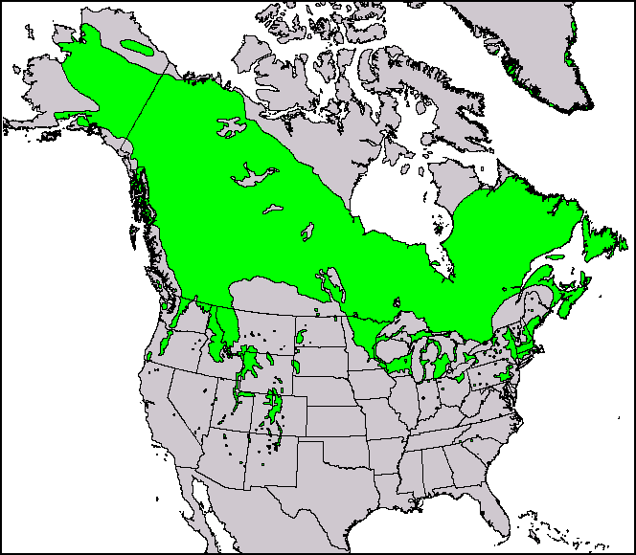
What are species distribution models?
Model the spatial distribution of a species or collection of species.

Slide 3
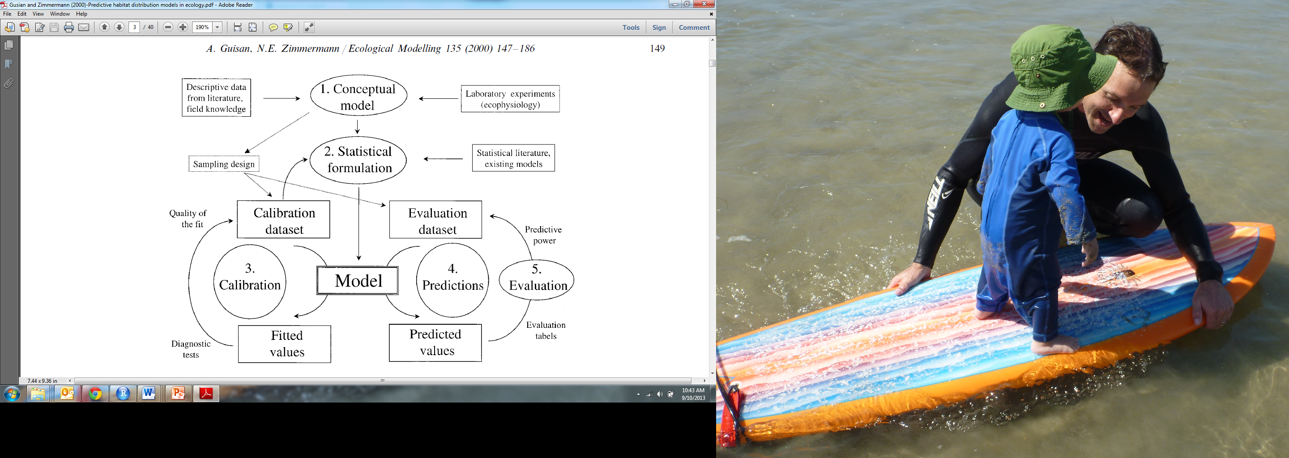
What are species distribution models?
Notes:
I found this simple diagram, I will let you study it for about 15 minutes then I will come back and let you ask questions.

Slide 4
What are species distribution models?
Notes:
Seriously, lets start here.

Slide 5
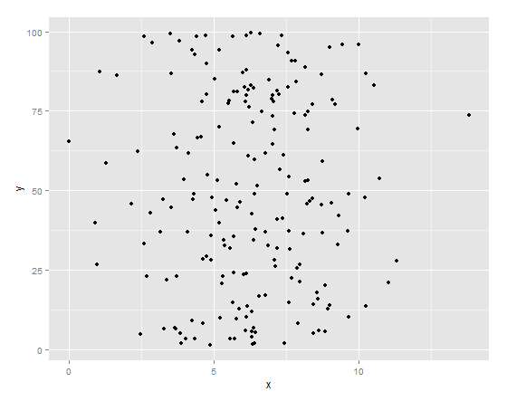
What are species distribution models?
Species are generally not randomly distributed through space
Random

Slide 6
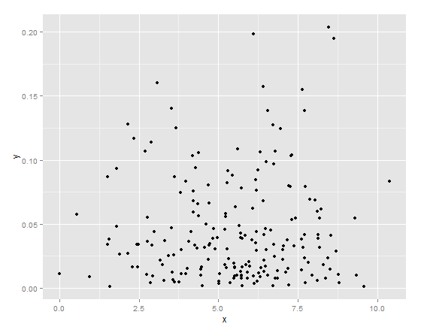
What are species distribution models?
Species are generally not randomly distributed through space
Random
Clumped

Slide 7
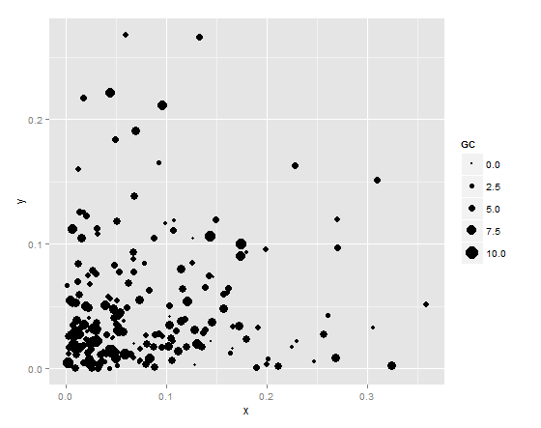
What are species distribution models?
Species are generally not randomly distributed through space
Random
Clumped
Clumped with Intensity

Slide 8
What are species distribution models?
Species distribution models attempt to model a species distribution as a function of environmental covariates.
Notes:
This can help us explain important environmental requirements for a species.

Slide 9
Many Names
Species Distribution Models
Ecological niche models
Environmental niche models
Climatic niche models
Habitat modeling
Climate envelope models
Bioclimatic envelope models
Bioclimatic modeling
Predictive distribution models
Predictive habitat models, etc…

Slide 10
Model Formulation
Notes:
Once you have defined the conceptual model, e.g. spatially clumped locations as a function of environmental covariates, you can choose a statistical formulation

Slide 11
Many Models
Climate envelope models (BIOCLIM in DIVA-GIS)
GLM and GAM (Generalized linear and additive models)
LDA and RDA (discriminant alaysis)
Classification trees (Random Forest)
GARP (Genetic algorithm for rule set prediction)
Neural Networks
Maximum Entropy (MaxEnt)
Hierarchical Bayesian models
… but wait! There are More!

Slide 12
And More Models
Occupancy Models (MARK )
Ecological Niche Factor Analysis
MARS (Multivariate adaptive regression splines)
SVM (Support vector machines)
Stochastic gradient boosting
probably more…
Notes:
Whenever I see this many solutions to the same problem I raise my eyebrows a little bit. This usually means that none of the current models are really all that great.

Slide 13
Two Categories of Methods
Probabilistic (Model based, GLM etc.)
Generate a probability surface of species occurrence
Probabilities are absolute given a set of covariates
Can determine uncertainties of estimates
Inference is well studied and understood

Slide 14
Two Categories of Methods
Probabilistic (Model based, GLM etc.)
Generate a probability surface of species occurrence
Probabilities are absolute given a set of covariates
Can determine uncertainties of estimates
Inference is well studied and understood
Predictive (Algorithmic, MaxEnt etc.)
Generate a prediction surface of species occurrence
Can be very powerful
Uncertainties around predictions difficult to quantify
Inference not well understood (progress is being made)

Slide 15
Same Basic Formula
Geo-referenced Locality Data
Where the species is located
Environmental Covariates
Environmental values at species locations
Model or Algorithm
Probability or predicted surface of species locations and (sometimes) intensities
Species Distribution
Notes:
Even though there are many models

Slide 16
Geo-referenced Locality Data
Notes:
Once you have defined the model you can add data.

Slide 17
Geo-referenced Locality Data
Two main categories of location data

Slide 18
Geo-referenced Locality Data
Two main categories of location data
Presence-only Data
Museum records
Incidental records
No systematic survey
No absences

Slide 19
Geo-referenced Locality Data
Two main categories of location data
Presence-only Data
Museum records
Incidental records
No systematic survey
No absences
Presence-Absence Data
Systematic Surveys (National Breeding Bird Survey)
Are absences really absences??

Slide 20
Pros and Cons: Presence Only
Pros:
Generally large geographic areas of coverage
Can use data from multiple sources
Easier to do multi-species comparisons

Slide 21
Pros and Cons: Presence Only
Pros:
Generally large geographic areas of coverage
Can use data from multiple sources
Easier to do multi-species comparisons
Cons:
Many models not well suited for this type of data
Leads to the creation of “pseudo-absence” data
Less information (potentially)

Slide 22
Pros and Cons: Presence/Absence
Pros:
Potentially more information-rich data
Fits existing model structures well

Slide 23
Pros and Cons: Presence/Absence
Pros:
Potentially more information-rich data
Fits existing model structures well
Cons:
More limited geographic coverage (generally)
More expensive to generate
Are absences really absences?
Detection probability models/ Occupancy Models

Slide 24
Model Evaluation/ Adequacy
Notes:
I found this really simple diagram for model fitting and evaluation.

Slide 25
Model Evaluation/ Adequacy
Notes:
Now we get to this mess down here.

Slide 26
Model Evaluation/ Adequacy
Measure of Model Fit
Cross Validation
Can use measures of variation in model fit metrics between folds of cross-validation (such as the range or standard error) to determine model adequacy.
Notes:
Models are generally evaluated through a combination of some measure of model fit and cross-validation with independent data.

Slide 27
Model Fit Measures

Slide 28
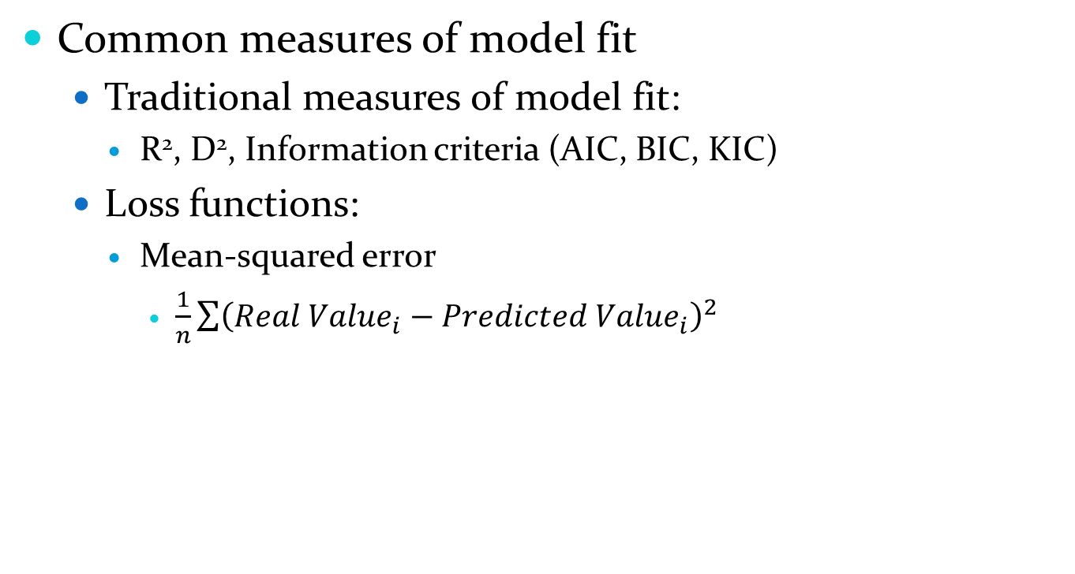
Model Fit Measures
Common measures of model fit
Traditional measures of model fit:
R², D², Information criteria (AIC, BIC, KIC)
Loss functions:
Mean-squared error
$\frac{1}{n}\sum{{\left({Real Value}_{i}−{Predicted Value}_{i}\right)}^{2}}$

Slide 29
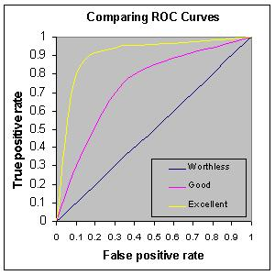
Model Fit Measures
Common measures of model fit
Loss functions:
AUC (area under the curve)
Gives a measure of the error rate for both true positives and true negatives
From: Tape, DG http://gim.unmc.edu/dxtests
Notes:
Summarizes results from the extremes which isn’t very useful, equal weights to omission and comission errors, no information about the spatial distribution of errors, sensitive to the testing extent.

Slide 30
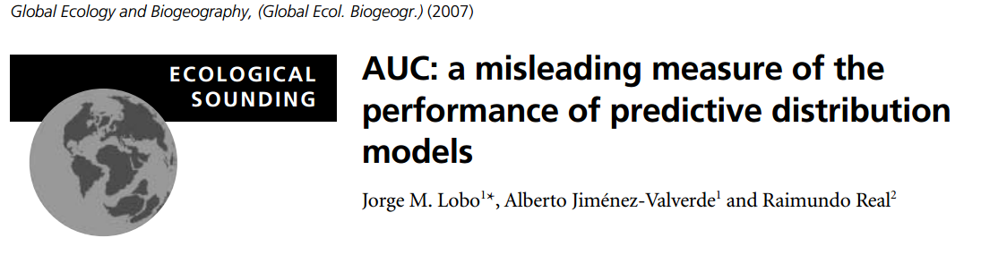
Model Fit Measures
Common measures of model fit
AUC (area under the curve)
Gives a measure of the error rate for both true positives and true negatives
Not well suited for presence only data but still frequently used
Notes:
Summarizes results from the extremes which isn’t very useful, equal weights to omission and comission errors, no information about the spatial distribution of errors, sensitive to the testing extent.

Slide 31
Cross-validation

Slide 32
Cross-validation
Omit some data from model training to perform model testing.
Well studied method in machine learning literature

Slide 33
Cross-validation
Omit some data from model training to perform model testing.
Well studied method in machine learning literature
Many of the flexible algorithms mentioned before rely on this to avoid over-fitting

Slide 34
Cross-validation
Omit some data from model training to perform model testing.
Well studied method in machine learning literature
Many of the flexible algorithms mentioned before rely on this to avoid over-fitting
Special concerns for cross-validation with spatial data

Slide 35
Cross-validation
Omit some data from model training to perform model testing.
Well studied method in machine learning literature
Many of the flexible algorithms mentioned before rely on this to avoid over-fitting
Special concerns for cross-validation with spatial data
Are k-fold data sets independent?

Slide 36
Cross-validation
Omit some data from model training to perform model testing.
Well studied method in machine learning literature
Many of the flexible algorithms mentioned before rely on this to avoid over-fitting
Special concerns for cross-validation with spatial data
Are k-fold data sets independent?
Spatial auto-correlation can inflate performance and under-estimate error <-serious problem!

Slide 37
Why Do We Need SDMs?

Slide 38
Why Do We Need SDMs?
SDMs can answer important questions in conservation, ecology, and evolution

Slide 39
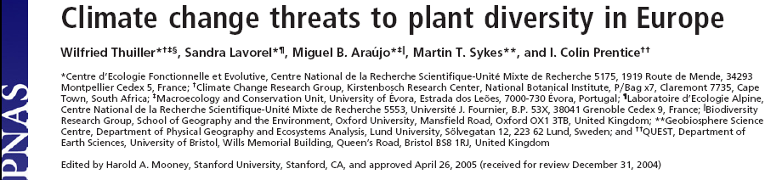
Examples
How will species distributions change with climate change?

Slide 40
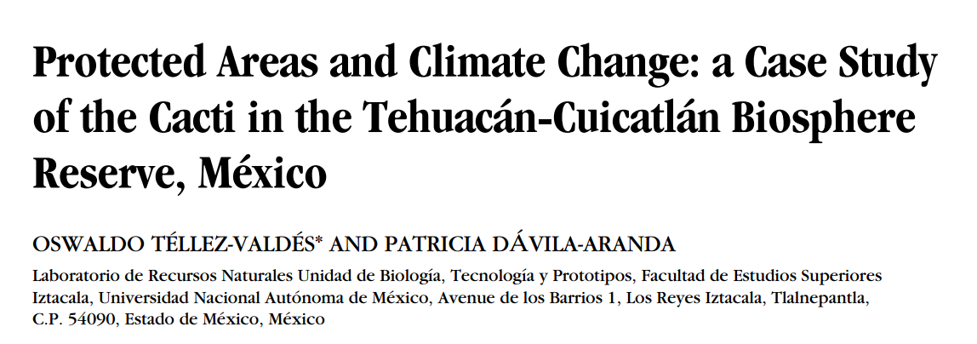
Examples
How will these shifts affect conservation efforts?

Slide 41
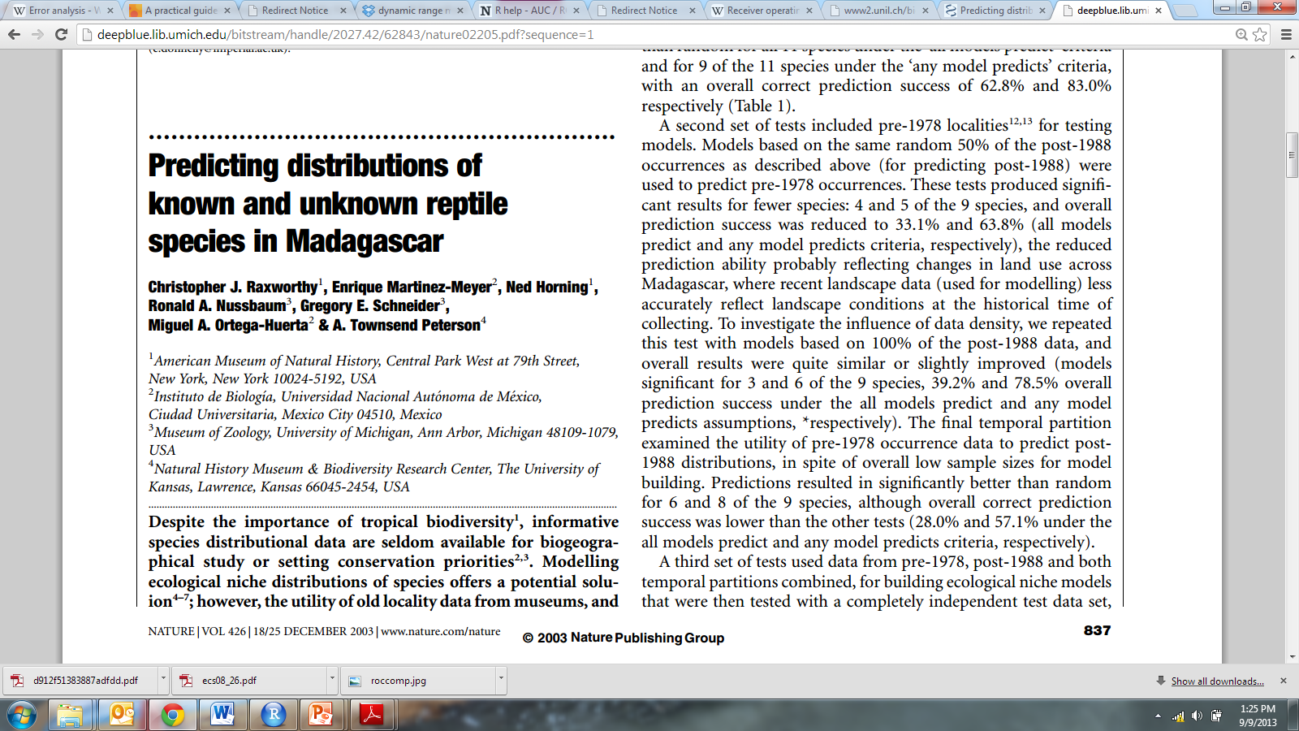
Examples
Predict unkown species ranges

Slide 42
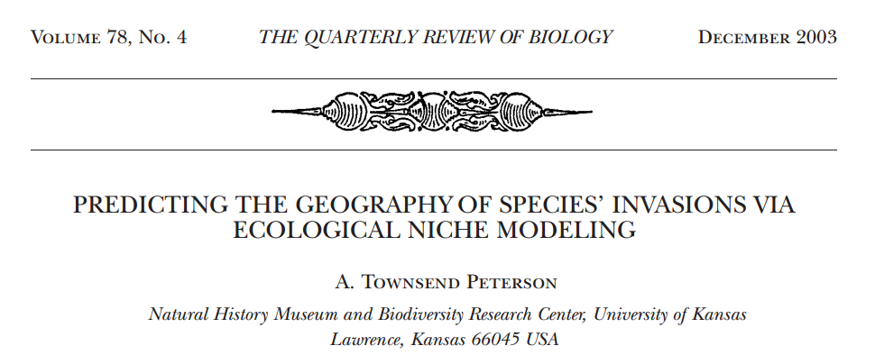
Examples
Predict invasive species ranges
Notes:
Species’ invasions have long been regarded as enormously complex processes, so complex as to defy
predictivity. Phases of this process, however, are emerging as highly predictable: the potential geographic
course of an invasion can be anticipated with high precision based on the ecological niche characteristics
of a species in its native geographic distributional area. This predictivity depends on the premise that
ecological niches constitute long-term stable constraints on the potential geographic distributions of
species, for which a sizeable body of evidence is accumulating. Hence, although the entire invasion
process is indeed complex, the geographic course that invasions are able to take can be anticipated with
considerable conﬁdence.

Slide 43
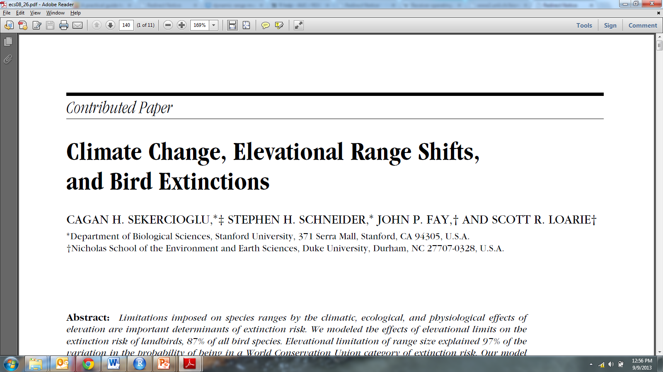
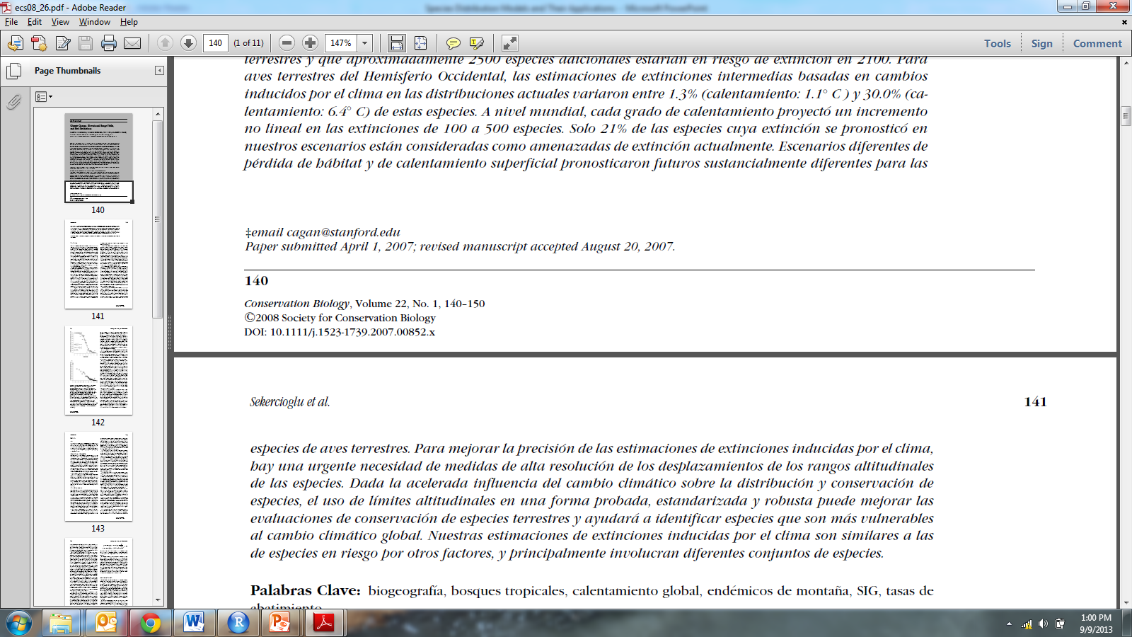
Examples
Meta-analyses
Notes:
Limitations imposed on species ranges by the climatic, ecological, and physiological effects of
elevation are important determinants of extinction risk. We modeled the effects of elevational limits on the
extinction risk of landbirds, 87% of all bird species. Elevational limitation of range size explained 97% of the
variation in the probability of being in a World Conservation Union category of extinction risk. Our model
that combined elevational ranges, four Millennium Assessment habitat-loss scenarios, and an intermediate
estimate of surface warming of 2.8◦ C, projected a best guess of 400–550 landbird extinctions, and that
approximately 2150 additional species would be at risk of extinction by 2100. For Western Hemisphere
landbirds, intermediate extinction estimates based on climate-induced changes in actual distributions ranged
from 1.3% (1.1◦ C warming) to 30.0% (6.4◦ C warming) of these species. Worldwide, every degree of warming
projected a nonlinear increase in bird extinctions of about 100–500 species. Only 21% of the species predicted
to become extinct in our scenarios are currently considered threatened with extinction. Different habitat-loss
and surface-warming scenarios predicted substantially different futures for landbird species. To improve the
precision of climate-induced extinction estimates, there is an urgent need for high-resolution measurements
of shifts in the elevational ranges of species. Given the accelerating influence of climate change on species
distributions and conservation, using elevational limits in a tested, standardized, and robust manner can
improve conservation assessments of terrestrial species and will help identify species that are most vulnerable
to global climate change. Our climate-induced extinction estimates are broadly similar to those of bird species
at risk from other factors, but these estimates largely involve different sets of species.

Slide 44
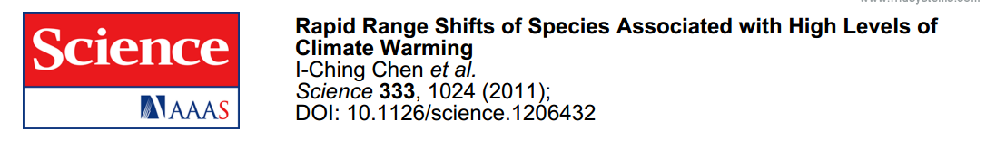
Examples
Meta-analyses

Slide 45
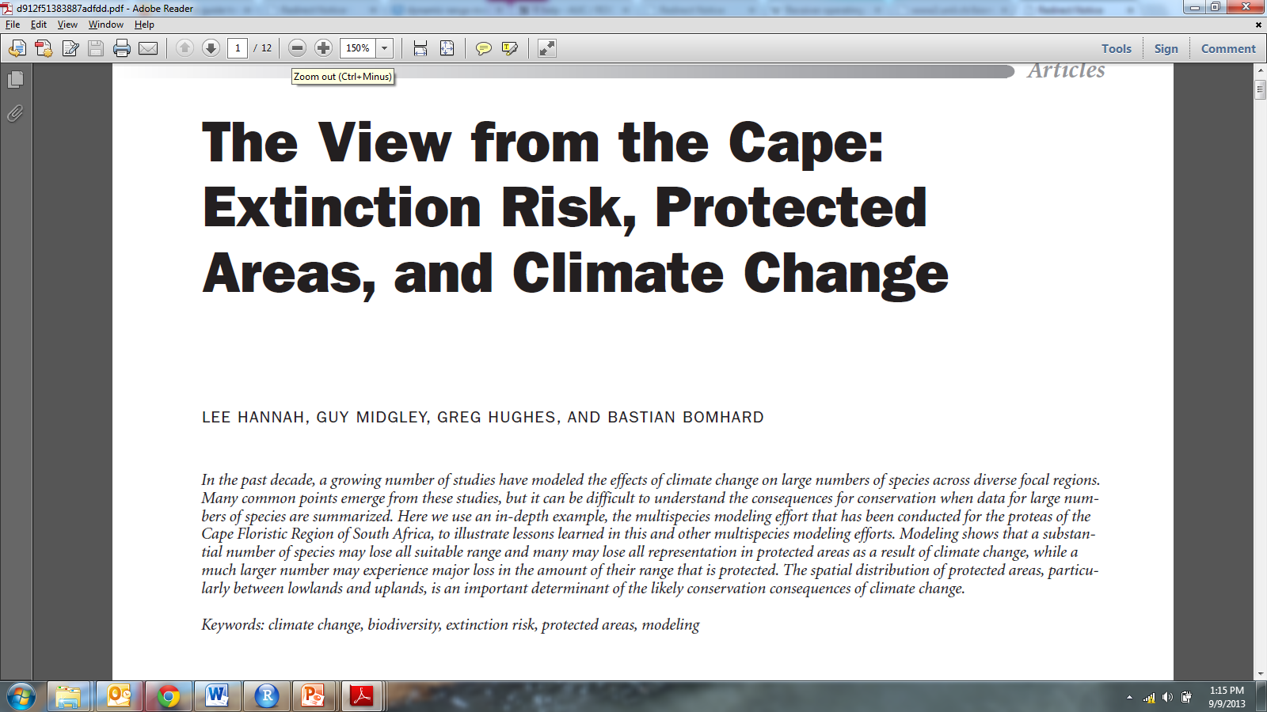
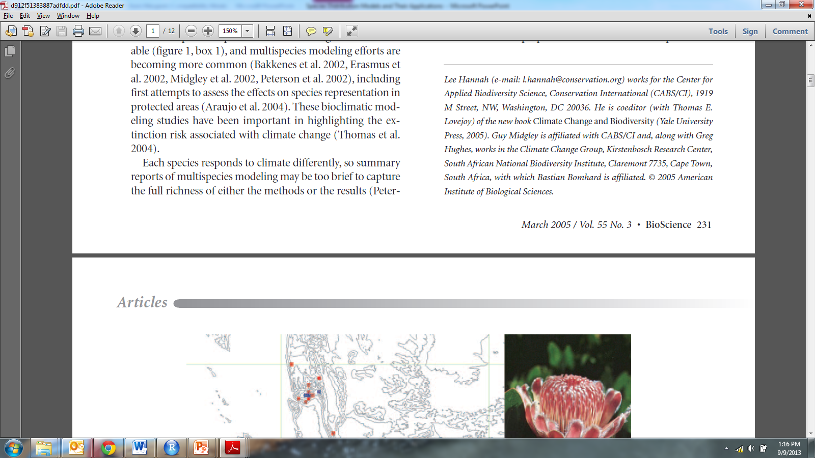
Examples
Meta-analyses
Notes:
The distributions of many terrestrial organisms are currently shifting in latitude or elevation in response to changing climate. Using a meta-analysis, we estimated that the distributions of species have recently shifted to higher elevations at a median rate of 11.0 meters per decade, and to higher latitudes at a median rate of 16.9 kilometers per decade. These rates are approximately two and three times faster than previously reported. The distances moved by species are greatest in studies showing the highest levels of warming, with average latitudinal shifts being generally sufficient to track temperature changes. However, individual species vary greatly in their rates of change, suggesting that the range shift of each species depends on multiple internal species traits and external drivers of change. Rapid average shifts derive from a wide diversity of responses by individual species.

Slide 46
Questions?

